Slide 1





P . E . A . R
Edwin Lim | Javier Wong | Jonathan Lee | Leonard Tan | Ong Hui Fen
A M A Z I N G W H A C K S E R V I C E S
Visit Us: http://www.amazing-whack-services.codes
Notes:
Visit our website: http://www.amazing-whack-services.codes

Slide 2
P R O B L E M & A P P R O A C H
The P.E.A.R. Framework
Why do youths not invest?
1
Information Overload
2
Excessive Jargon
3
Fear of Losing Money
A simple Google search on “investing for beginners” returns 395,000,000 results. Youths find it difficult to find reliable and understandable information online.
When searching for information on investing, the results are usually filled with technical jargon that is difficult for youths to understand. This acts as a deterrent for youths.
A study by GYC Financial Advisory shows that 61% of youth do not know how to invest. 30% of youths are not investing due to the fear of losing their investments.
To encourage and empower youths to make smart investing decisions, we need to simplify the process and provide directions
1
Profile
2
Educate
3
Apply
4
Review
We profile the user with a series of simple questions to gauge their current level of financial literacy, then guide them to the appropriate starting point in our educational resources.
We provide educational resources in a linear and modular manner through our Academy. This provides a clear direction for users’ learning and they can use checkpoints to mark their progress.
Users apply the concepts they learn from our Academy by using our Financials function to read company financial statements. They can also use our Virtual Portfolio to plan and simulate their own investments.
By tracking the progress of their Virtual Portfolio and understanding the impact of their investment decisions, users can learn and become more confident at investing.
Notes:
Are youths ready for financial independence? (2016). Retrieved September 07, 2020, from https://www.gyc.com.sg/files/youthinvesting.pdf

Slide 3










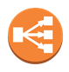

T E C H N O L O G Y
Technology and Frameworks Used
Front End Technology
ReactJS – used for efficient rendering and updating of webpages
React Bootstrap – used for UI interface elements
NextJS – used for routing
Docker – containerisation of web service for easy deployment
External APIs
Tradingview – used for dynamic real-time market data and charts
yFinance – extracted data transformed and used to load standardized financial reports
NewsAPI – used for dynamic real-time news feed
Back End Technology
AWS Elastic Beanstalk – orchestrates AWS service for seamless deployment
AWS Cloudwatch – monitoring and alerts for webservice
AWS Elastic Load Balancer – creates extremely scalable webservice with automatic load balancing
mongoDB – NoSQL database program for data storage
Flask – web framework

Slide 4
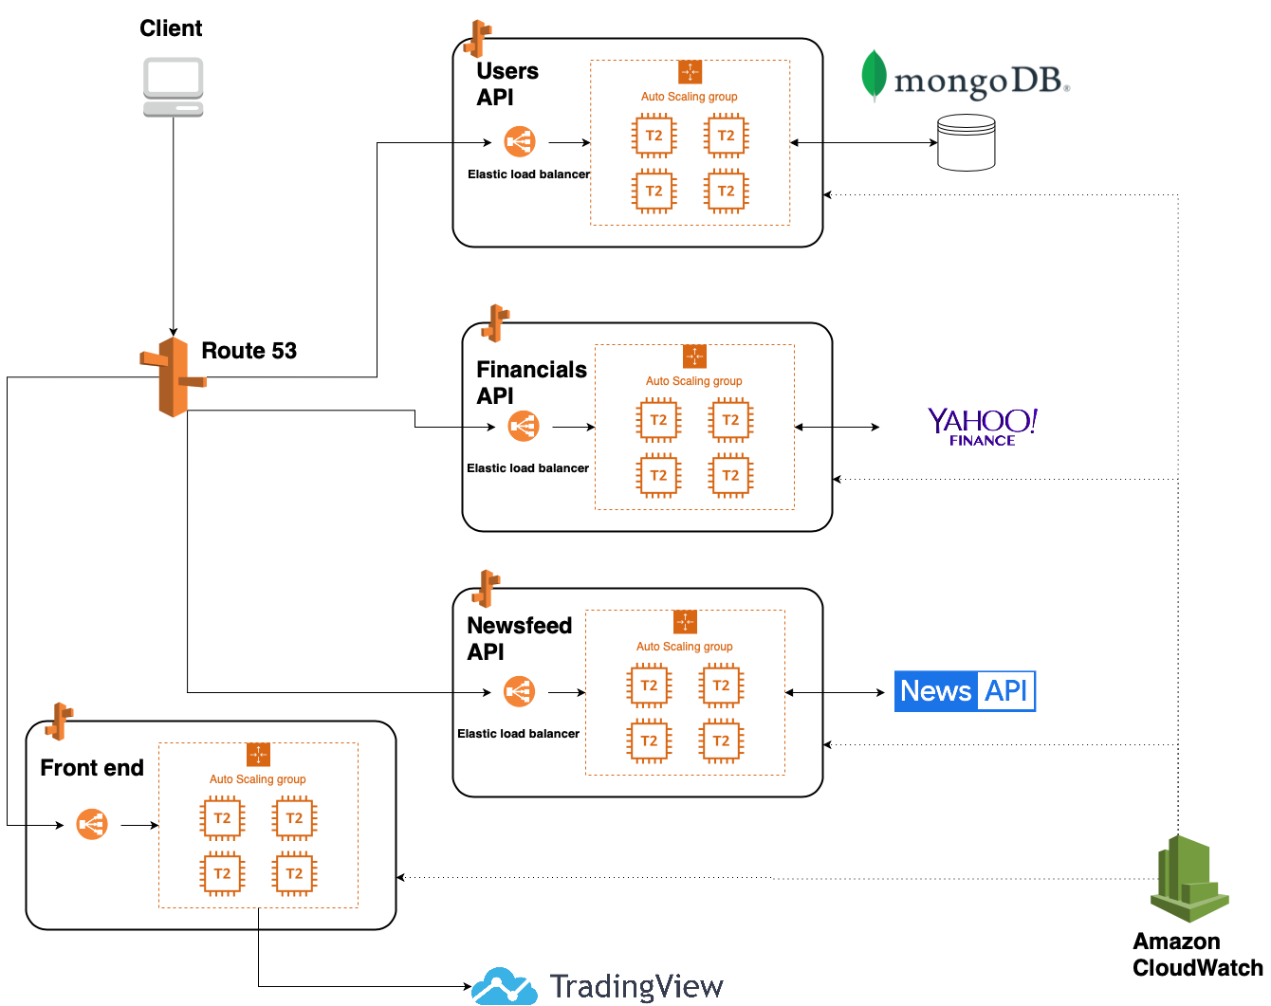
S O L U T I O N A R C H I T E C T U R E
Solution Architecture

Slide 5

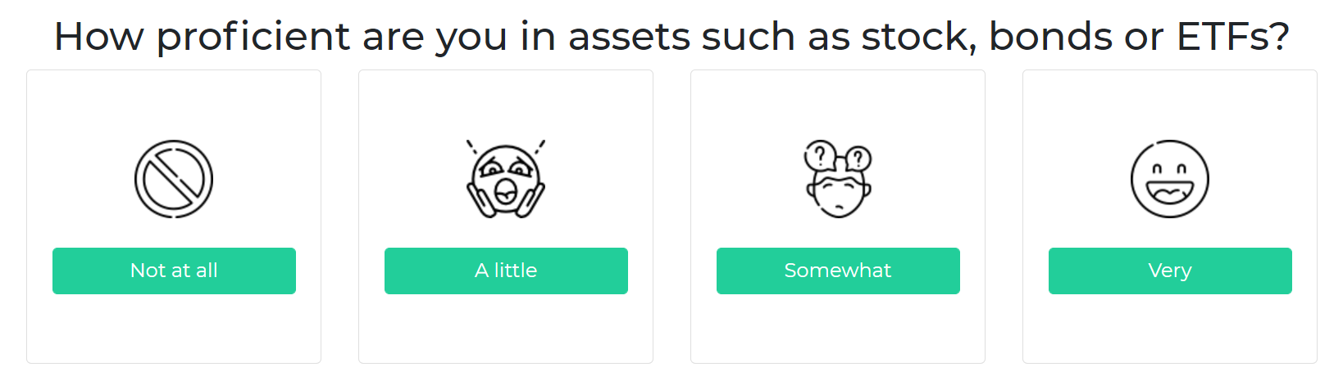

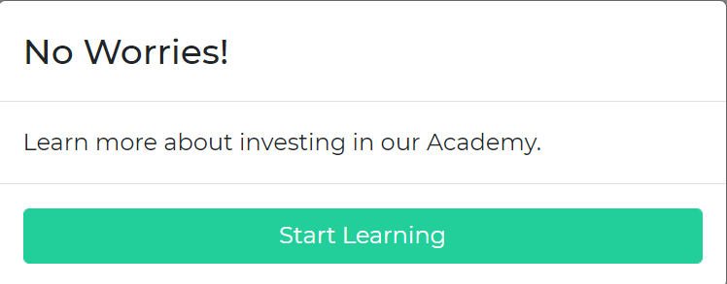
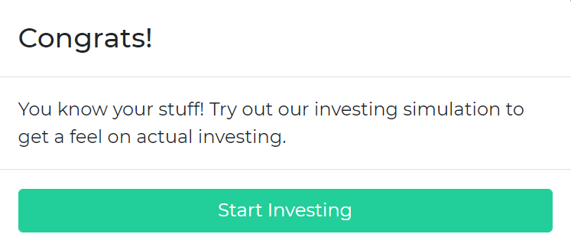
S O L U T I O N
Landing Page & Profiling Questionnaire
Landing Page Objectives
Problem
Solution: Profile
Minimalistic
News Exposure
P
Unsure of where to Begin
S
Understand the User
To avoid overwhelming youths with information, we simplify the landing page with only a “Get Started” Button needed to begin.
We use a newsfeed carousel to expose users to headlines as accumulating general knowledge is important for aspiring investors.
Financial knowledge is so vast and scattered that youths do not know where they should start from.
Our profiling system guides youths through a simple and intuitive questionnaire to determine a tailored starting point.

Slide 6

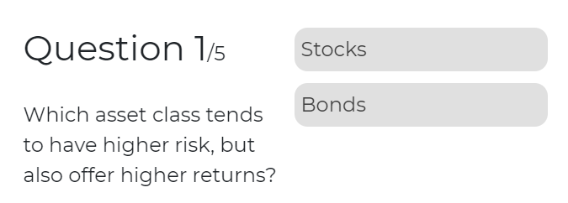
S O L U T I O N
The Academy
Problem
P
Excessive Jargon
Financial knowledge is so vast and scattered that youths do not know where they should start from.
Solution: Educate
S1
Build Foundations
A structured course for youths to learn essential financial concepts. The course includes videos and easily understandable explanations.
S2
Check for Understanding
A quiz is provided at the end of the course to test youths on their newly acquired knowledge.

Slide 7
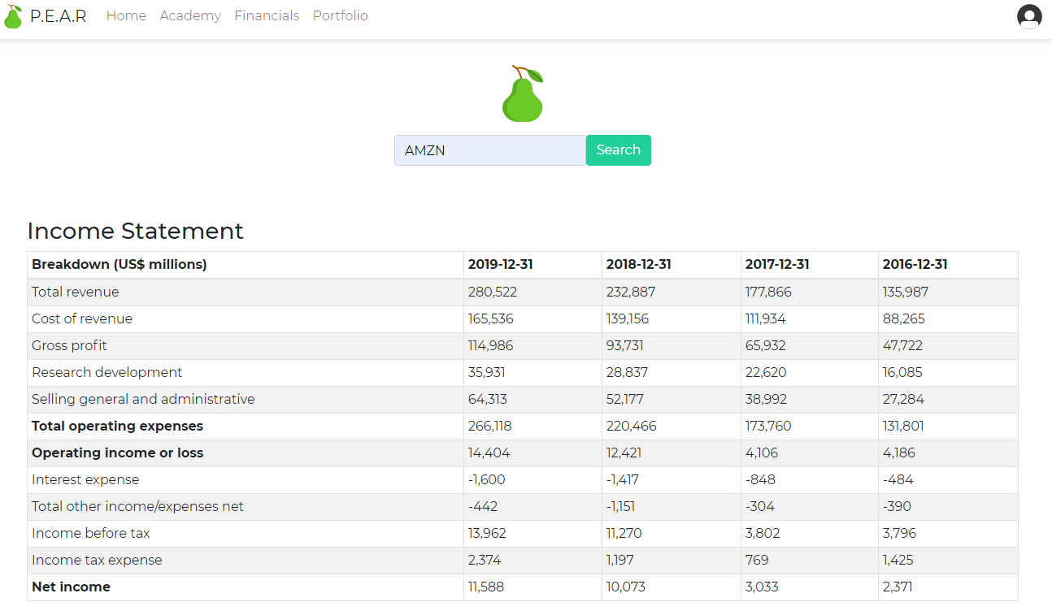
S O L U T I O N
Standardised Financial Statements
Problem
P
Confusing Financials
Often interchangeable terms (such as Profit, Income & Earnings) can confuse beginners trying to apply what they learned on real data.
Solution: Apply
S
Standardised Information
A simplified Financials page delivers essential and standardised information for users to practice applying financial analysis on.
* Due to time constraints, we have only rendered Income Statements for proof of concept

Slide 8
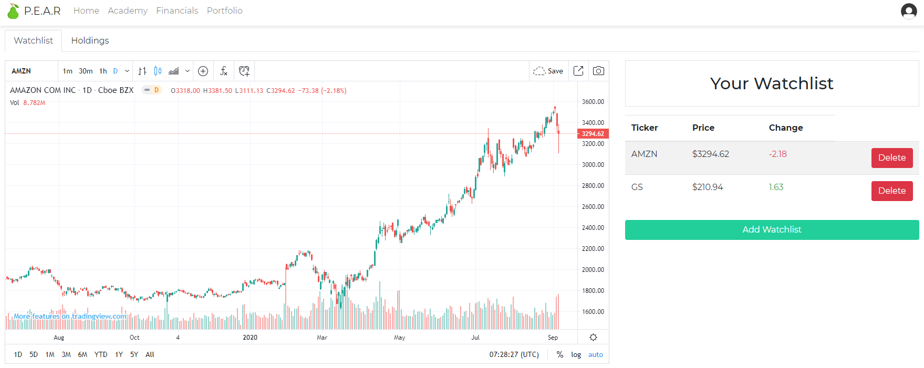
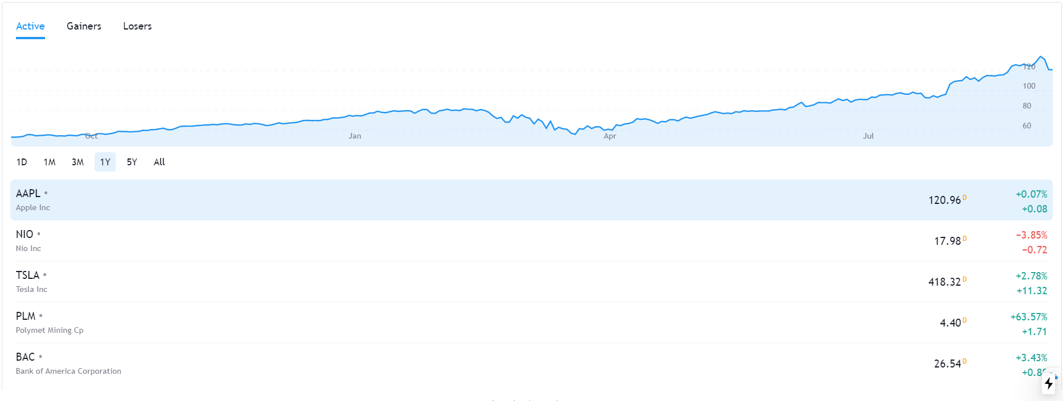
S O L U T I O N
Real-Time Virtual Portfolio
Problem
P
Fear of Losing Money
The fear of losing money and unfamiliarity with the financial markets deters youths from actively investing.
Solution: Apply
S1
Virtual Simulation
Instil confidence in the youths by giving them the opportunity to invest in a virtual simulation.
S2
Increase Engagement
Youths can create their own watchlists to stay in touch with the markets through real-time market and interactive charts.

Slide 9
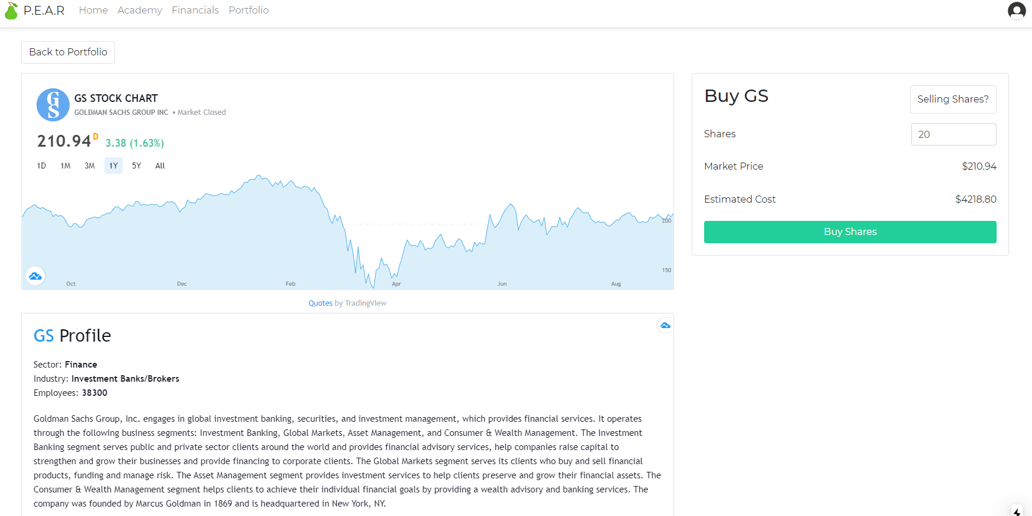
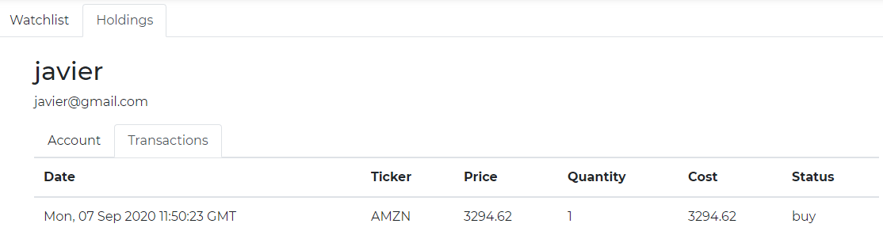
S O L U T I O N
Making Investment Decisions
Problem
P
Fear of Losing Money
The fear of losing money and unfamiliarity with the financial markets deters youths from actively investing.
Solution: Apply
S1
Extend Decisional Power
Youths are given the ability to make their own decisions for what asset and how much of it to purchase.
S2
Record the Journey
Investment decisions made in the past are recorded for the user to reflect on in the future.

Slide 10
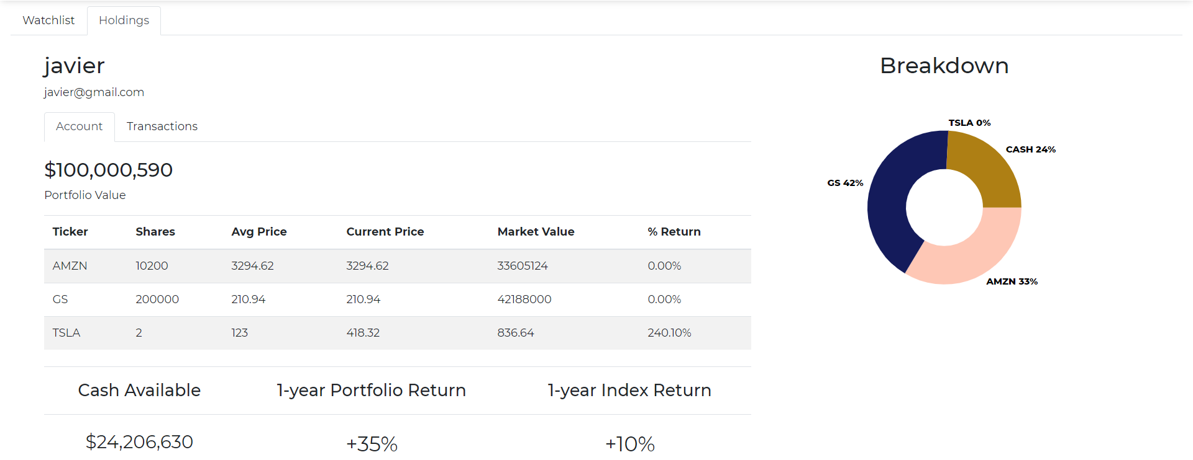
S O L U T I O N
Virtual Portfolio Holdings
Problem
P
Fear of Losing Money
The fear of losing money and unfamiliarity with the financial markets deters youths from actively investing.
Solution: Review
S1
Assess the Portfolio
Tabular information and visualisations help youths understand the distribution of their investments.
S2
Progress Review
* Due to time constraints, portfolio return and index return are hardcoded values
Youths can see the impact of their investment decisions and review their performance to learn from experience.

